Slide 1
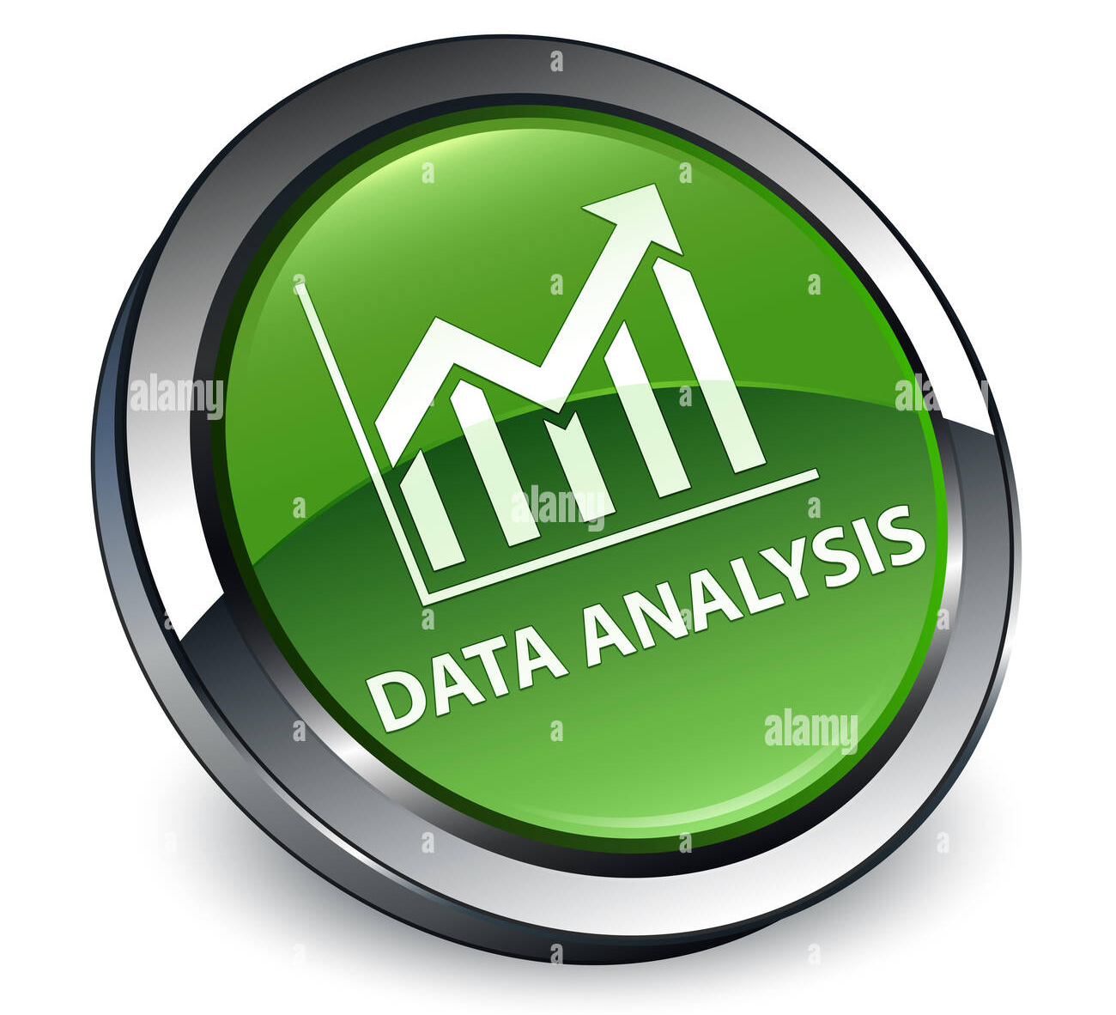


Customer Lifetime Value & Churn Risk Analytics Using Excel and SQL
MINI PROJECT -2
TEAM-1
SUMBITTED BY : | EZHILARASI K
DEPARTMENT : | ECE
PROJECT DOMAIN : | DATA ANALYTICS
TOOLS USED : | EXCEL AND MYSQL
COLLEGE NAME : | VIVEKANANDHA COLLEGE OF ENGINEERING FOR WOMEN

Slide 2

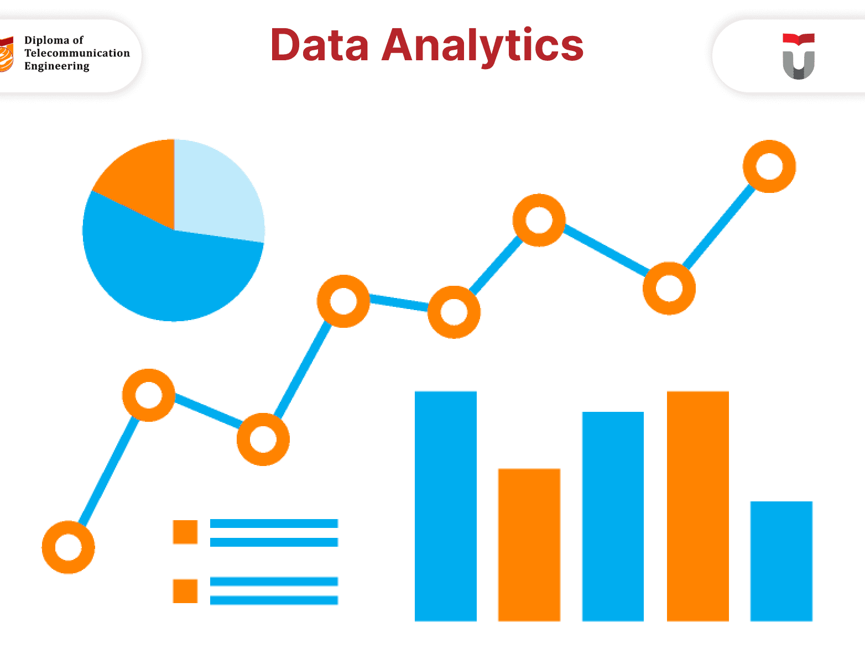
INTRODUCTION
Customer churn is one of the major challenges faced by telecom companies.
Businesses need to understand why customers stop using their services.
Data analytics helps identify customer behavior and churn patterns.
Excel and SQL are used to analyze and visualize customer information.
The project focuses on churn prediction and customer lifetime value analysis.
Insights from the project help improve customer satisfaction and revenue.

Slide 3

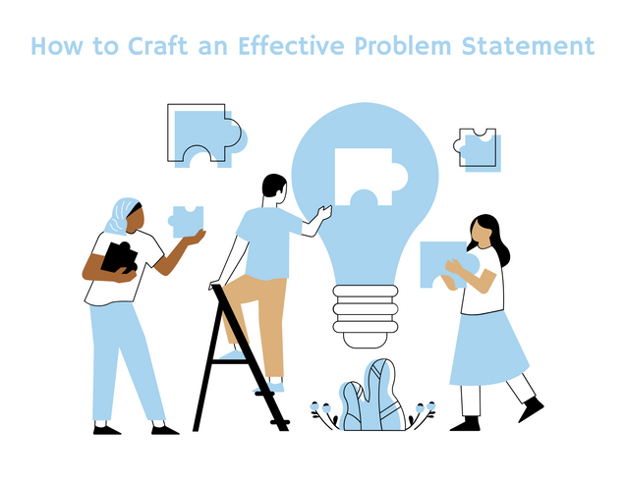
PROBLEM STATEMENT
Telecom companies lose customers due to various service-related issues.
Identifying high-risk customers manually is difficult and time-consuming.
Companies need a system to analyze customer churn efficiently.
Understanding customer value helps businesses prioritize retention strategies.
Lack of visualization makes business analysis difficult for decision-makers.
This project solves these issues using analytical dashboards and SQL queries.

Slide 4

OBJECTIVES
To analyze customer churn behavior using the Telco dataset.
To identify high-risk customers using risk categorization methods.
To calculate Customer Lifetime Value for each customer.
To create interactive dashboards using Excel Pivot Charts and Slicers.
To perform data analysis using SQL queries and conditional logic.
To generate business insights for improving customer retention strategies.

Slide 5
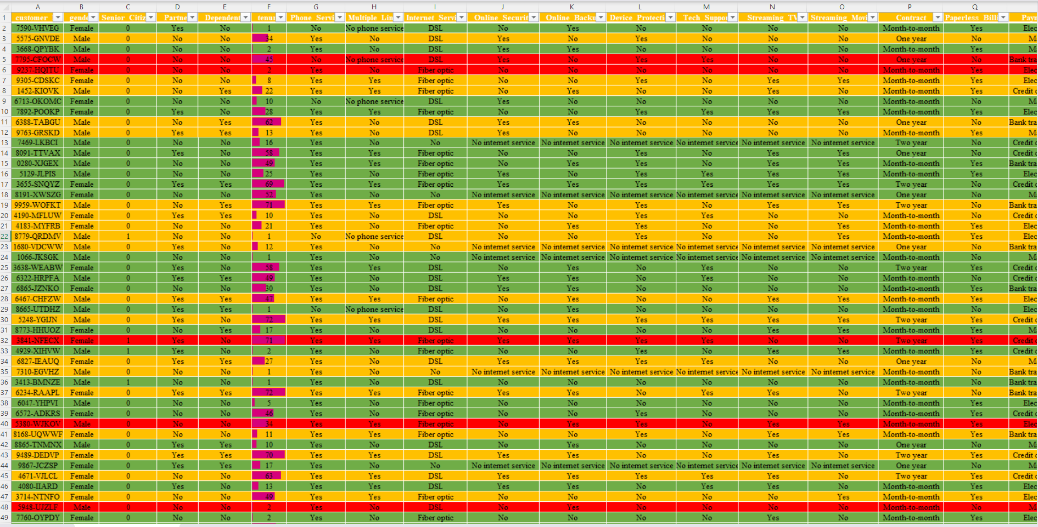
DATASET DESCRIPTION
The project uses the Telco Customer Churn dataset from Kaggle.
The dataset contains customer demographics and service details.
Important columns include tenure, contract, charges, and churn status.
Additional fields include internet service, payment method, and support details.
The dataset contains both numerical and categorical data.
The dataset is cleaned and transformed before performing analysis.

Slide 6

TOOLS AND TECHNOLOGIES USED
Microsoft Excel is used for data cleaning and dashboard creation.
SQL is used for querying and analyzing customer data.
Pivot Tables are used for summarizing large amounts of information.
Pivot Charts are used for creating attractive visualizations.
Conditional Formatting is applied for highlighting risky customers.
Slicers are used for interactive dashboard filtering and analysis.

Slide 7

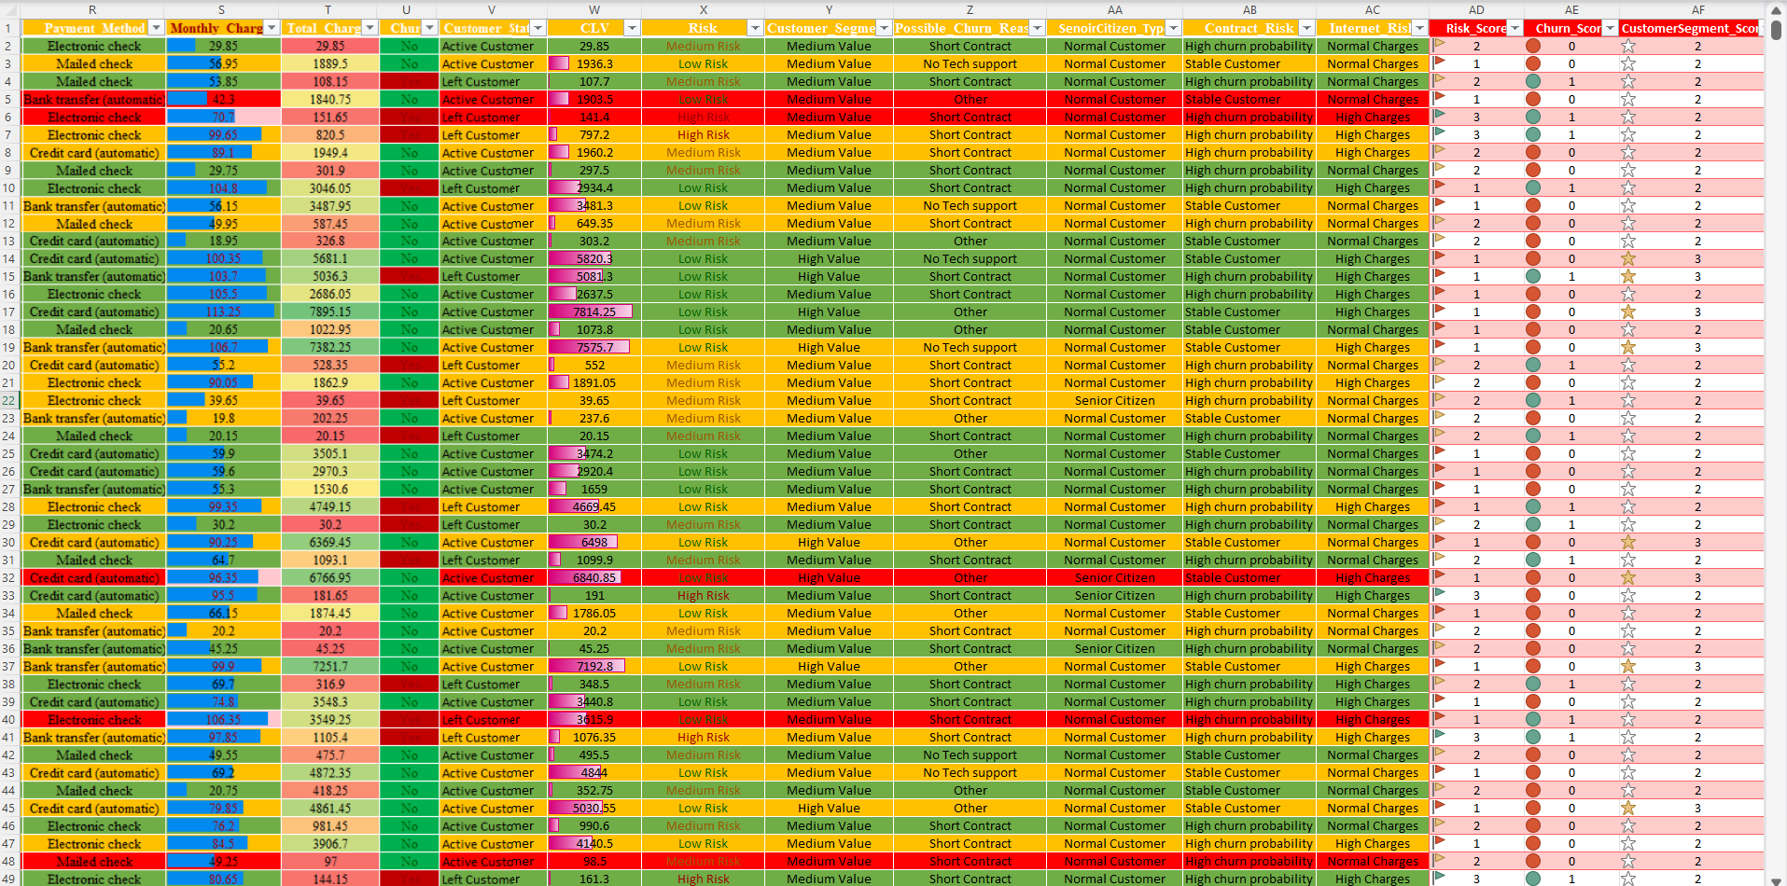
EXCEL DATA CLEANING
Blank values and duplicate records are removed from the dataset.
Data types are corrected for numerical and text columns.
New calculated columns are created for better analysis.
Customer status and risk category columns are added.
CLV and customer segmentation columns are generated using formulas.
Cleaned data is converted into Excel tables for analysis.

Slide 8
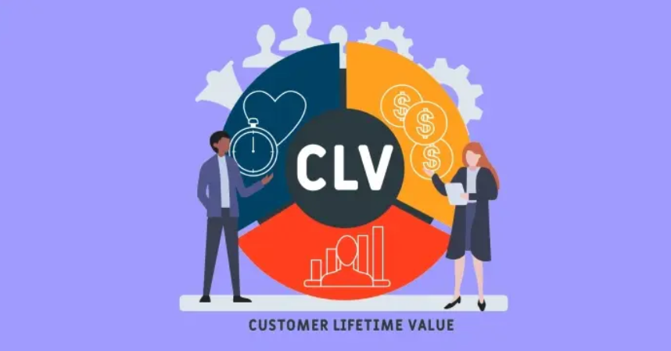
CUSTOMER LIFETIME VALUE ANALYSIS
Customer Lifetime Value measures the total value generated by customers.
CLV is calculated using monthly charges and customer tenure.
Customers are categorized into high, medium, and low value segments.
High-value customers contribute more revenue to the company.
CLV analysis helps businesses focus on important customers.
Data bars and charts are used to visualize customer value.

Slide 9

CHURN RISK ANALYSIS
Risk categories are created to identify churn probability.
Customers with low tenure and high charges are marked as high risk.
Conditional formatting highlights risky customers using colors.
High-risk customers are analyzed using Pivot Tables and charts.
Risk analysis helps companies take preventive retention actions.
The dashboard provides a quick overview of customer risk levels.

Slide 10
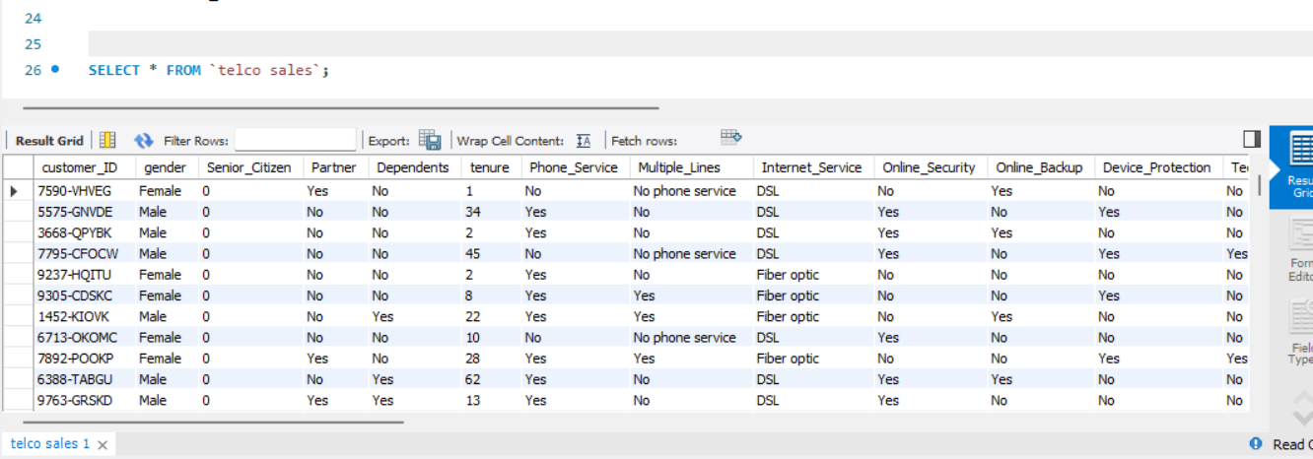
SQL DATABASE ANALYSIS
SQL queries are used for customer churn analysis and segmentation.
Aggregate functions such as COUNT and AVG are used in analysis.
GROUP BY and CASE statements help categorize customers.
SQL queries calculate churn count and customer value metrics.
Risk categories are generated using SQL conditional statements.
SQL improves data management and business reporting efficiency.

Slide 11
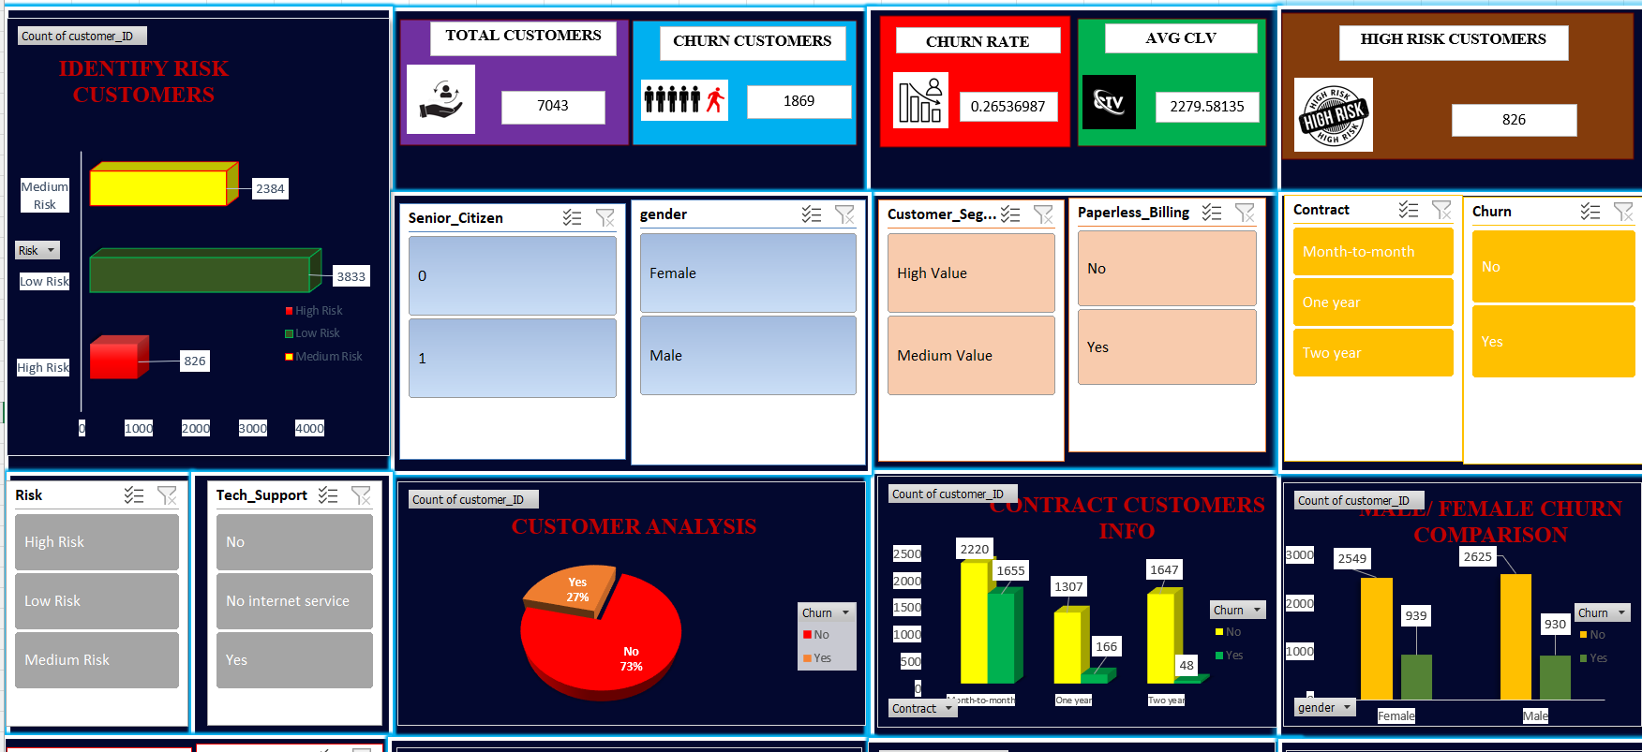
DASHBOARD CREATION
Interactive dashboards are created using Excel Pivot Charts.
KPI cards display important business metrics visually.
Charts are designed for churn, risk, contract, and CLV analysis.
Slicers allow users to filter data dynamically.
Conditional formatting improves dashboard readability and appearance.
The dashboard helps management understand customer trends quickly.

Slide 12
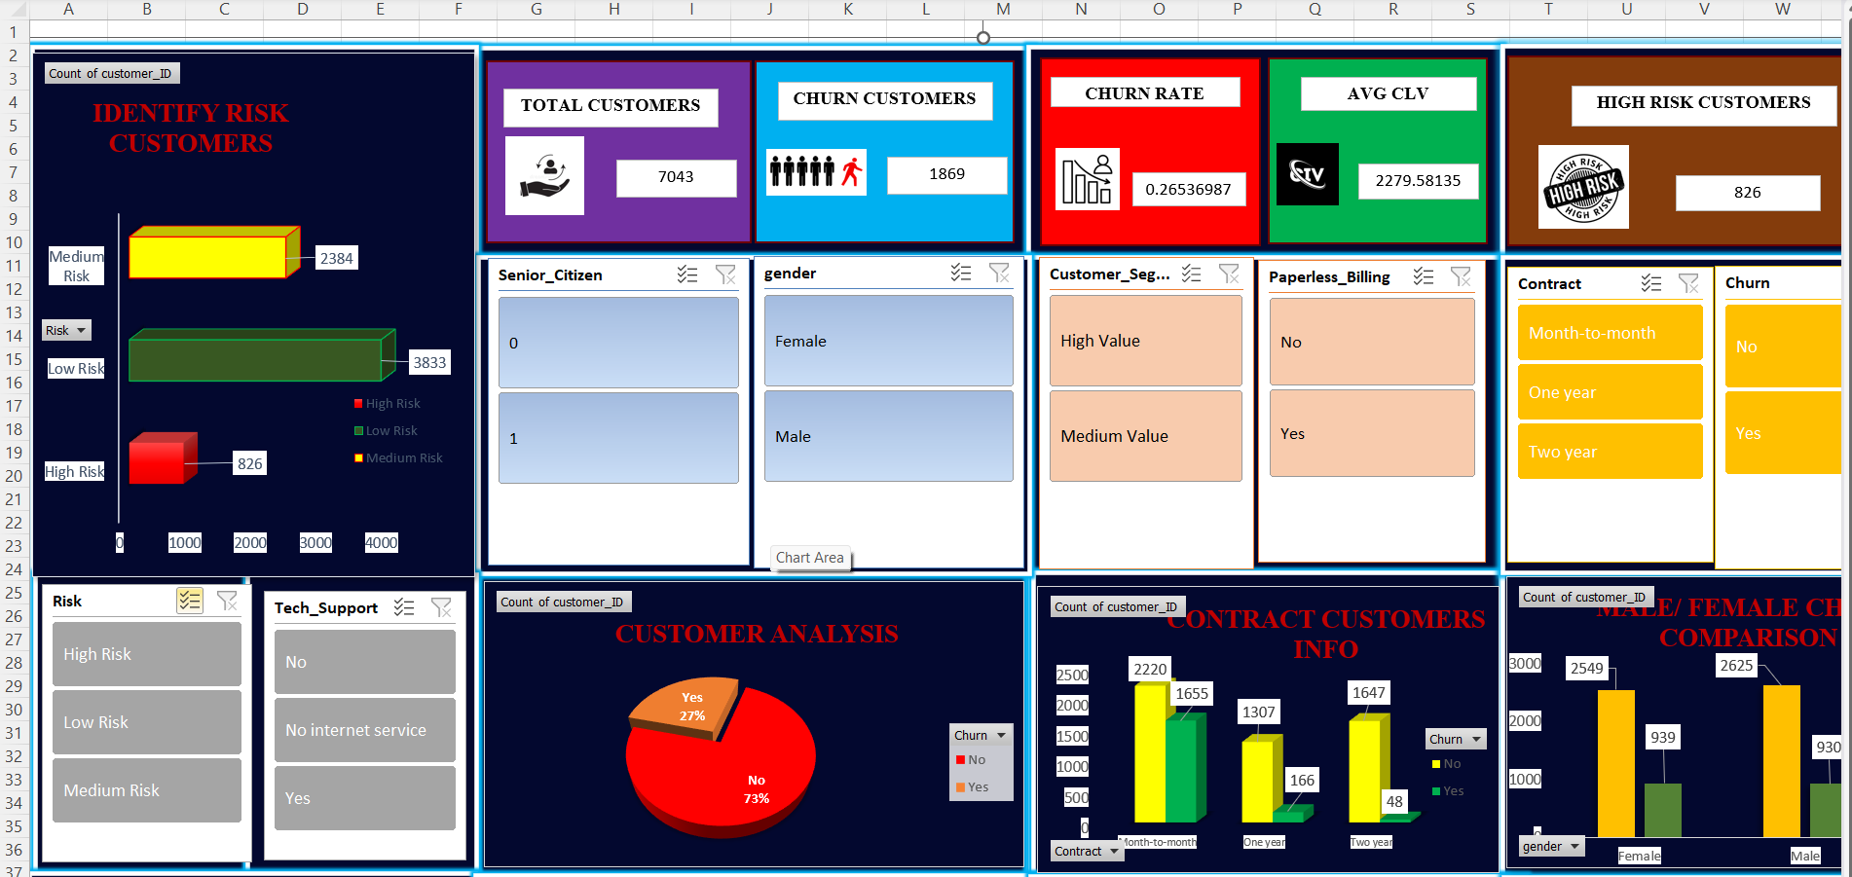
KPI CARDS
KPI cards summarize important metrics in the dashboard.
Total customers and churn customers are displayed clearly.
Churn rate shows the percentage of customers leaving the company.
Average CLV helps analyze customer revenue contribution.
High-risk customer count identifies customers likely to churn.
Retained customer count shows the number of active customers.

Slide 13
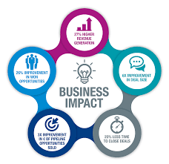
BUSINESS IMPACT
The project helps identify customers who are likely to churn and supports retention planning.
Customer Lifetime Value analysis helps businesses focus on high-value customers effectively.
Interactive dashboards improve business monitoring and data-driven decision-making.
Risk categorization reduces customer loss and improves customer satisfaction.
Excel and SQL analytics enhance operational efficiency and overall business performance.

Slide 14

RESULTS & OUTPUT
The project successfully analyzed customer churn and Customer Lifetime Value using Excel and SQL techniques.
High-risk customers and churn reasons were identified through data analysis and risk categorization.
Interactive dashboards with KPI cards, Pivot Charts, and slicers improved data visualization.
SQL queries and Excel analytics provided meaningful business insights and reporting efficiency.
The final output supports better customer retention strategies and business decision-making.

Slide 15
EXCEL AND SQL OUTPUT VISULAIZATION
The dataset contains customer details, CLV analysis, churn status, risk category, and possible churn reasons.
Additionally Conditional formatting, icons sets , and also using formula to created a new columns.

Slide 16
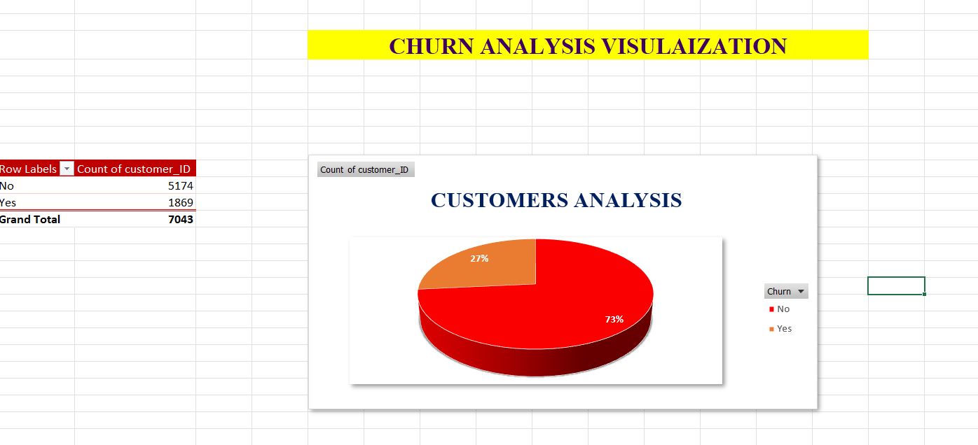
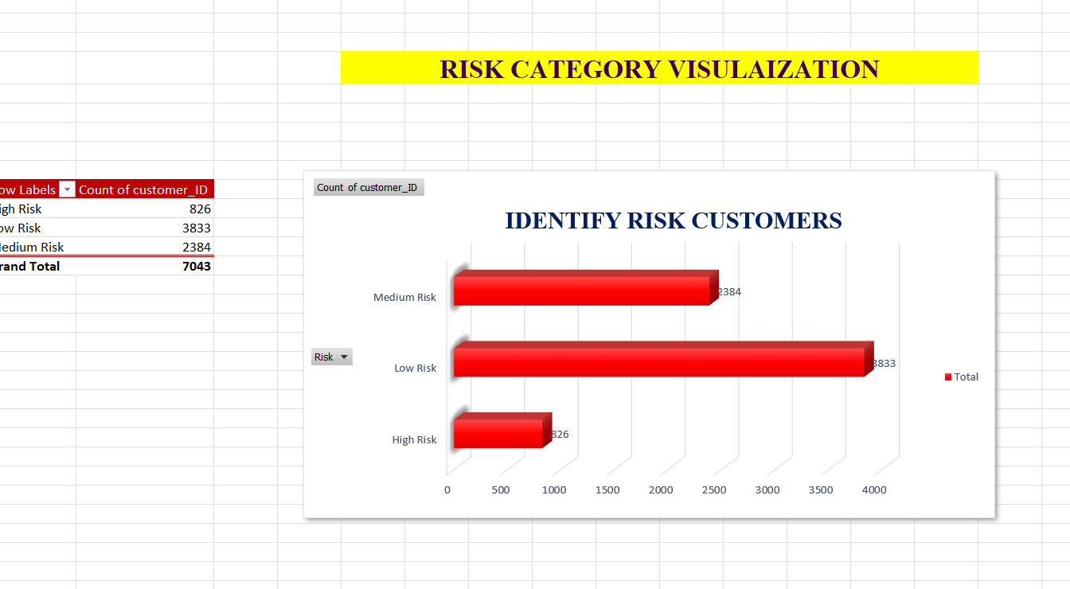
This analysis shows Customers
who stayed and customers who churned from the company.
This chart Categories customers high risk,medium and low risk groups using churn behavior analysis.

Slide 17
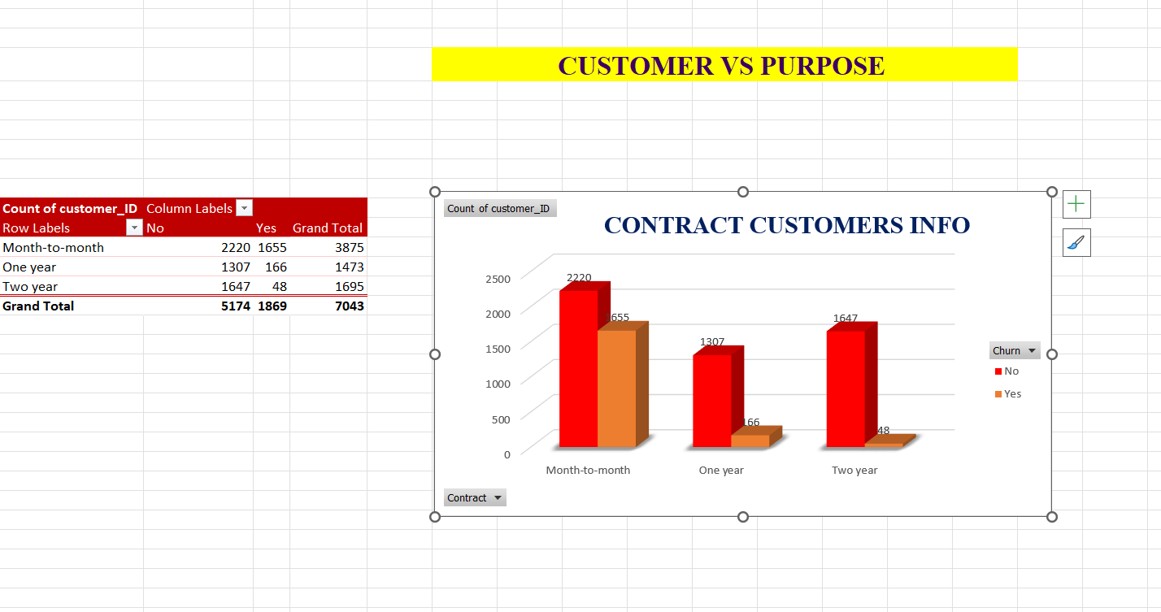
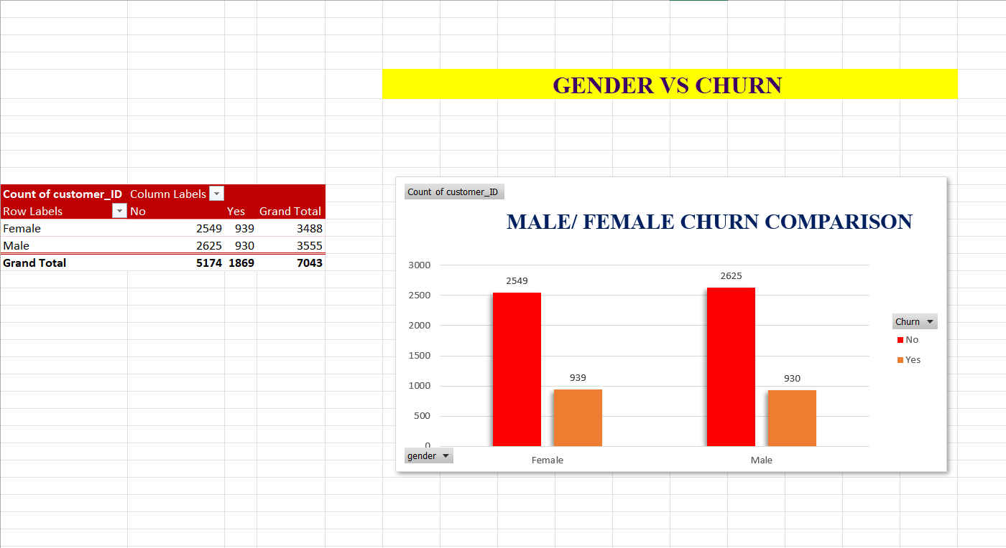
This analysis shows the contract customers information.
This chart compares the male female churn counts.

Slide 18
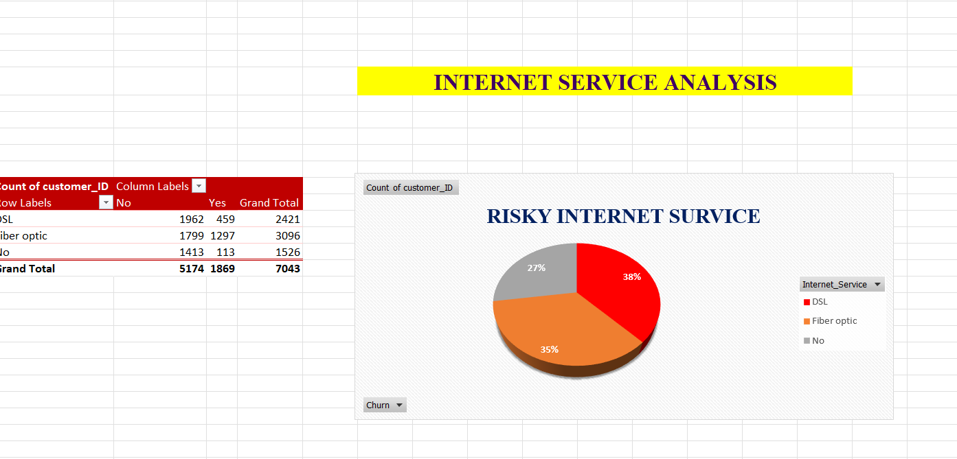
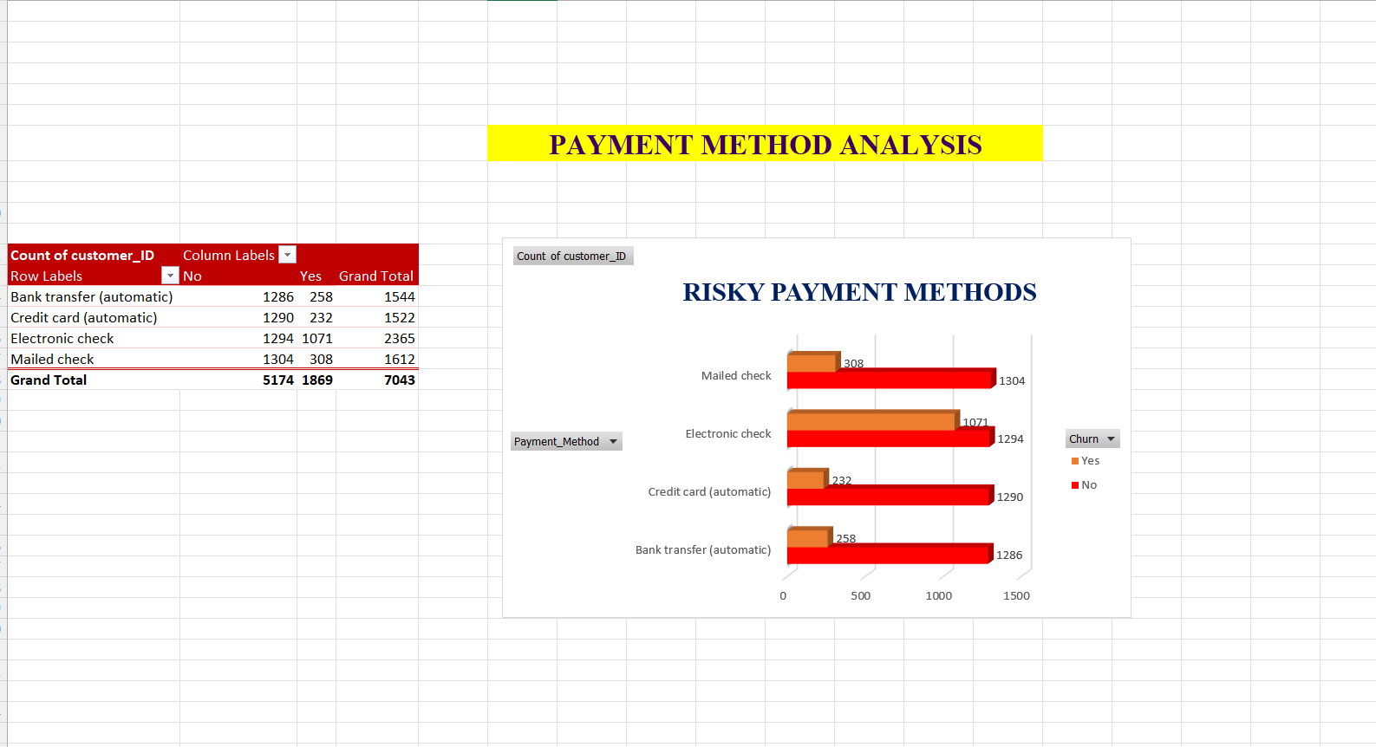
This analysis show the Risky internet services such as DSL, Fiber optic.
This Chart Identify the Payment methods for customers.

Slide 19
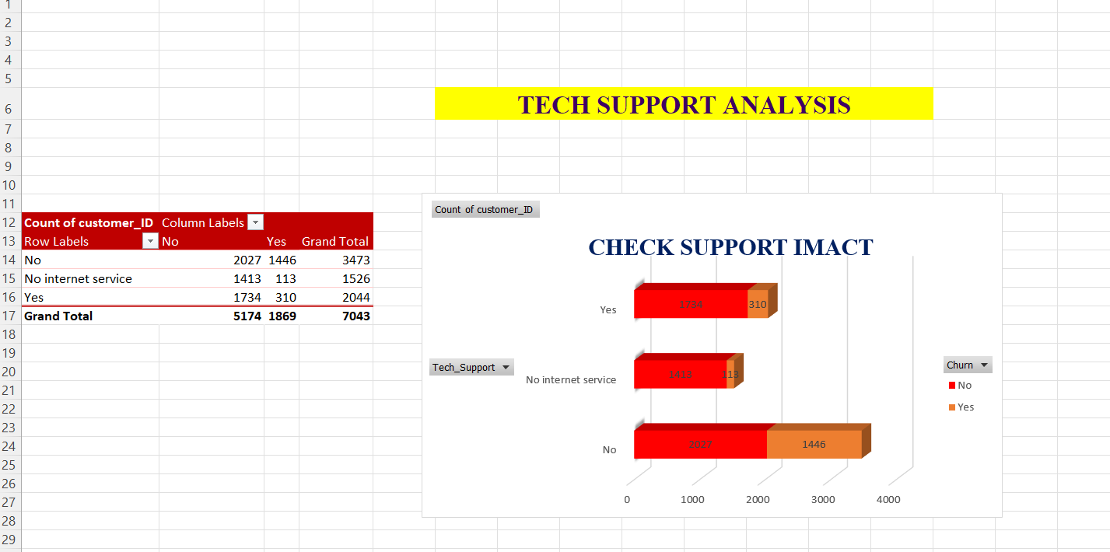
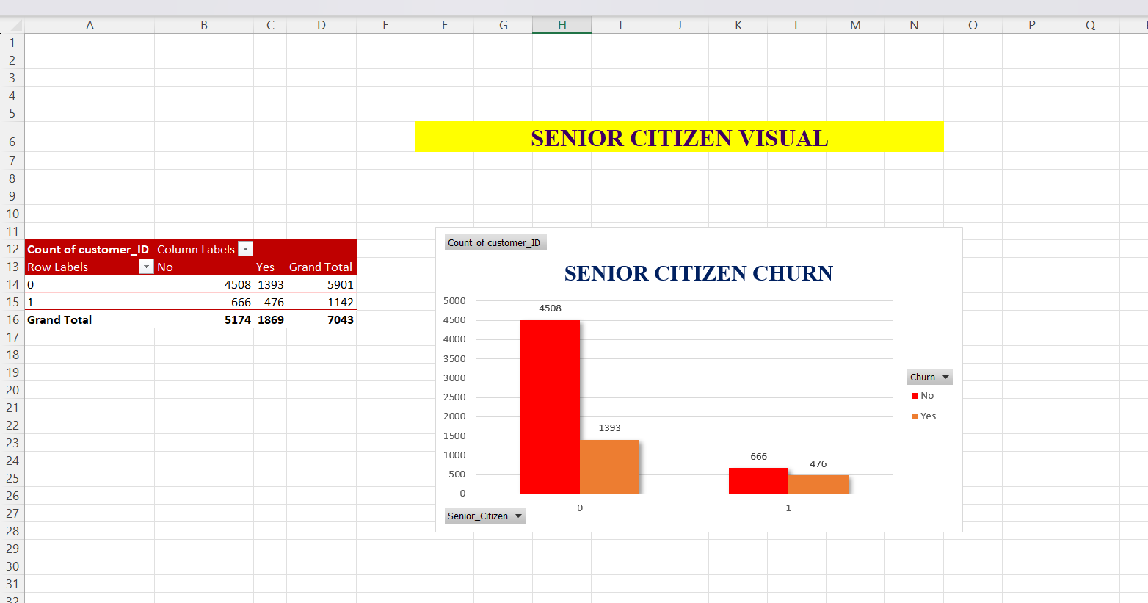
This Analysis check the Tech support impact
This Chart shows the information for the who are the senior citizens.

Slide 20
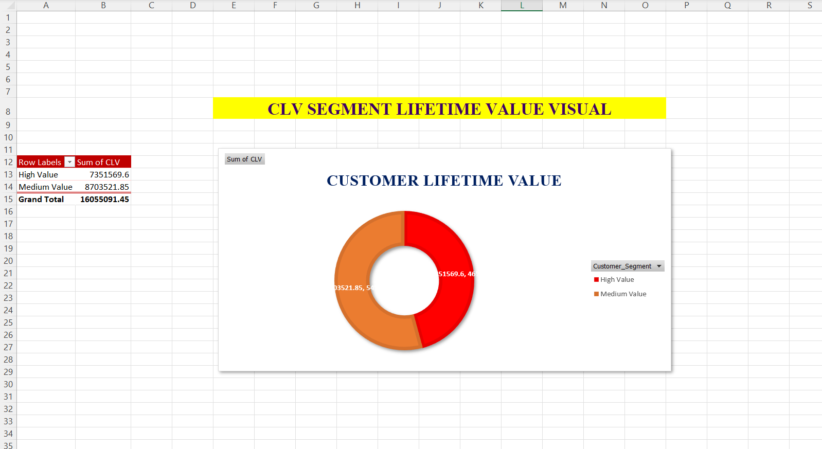
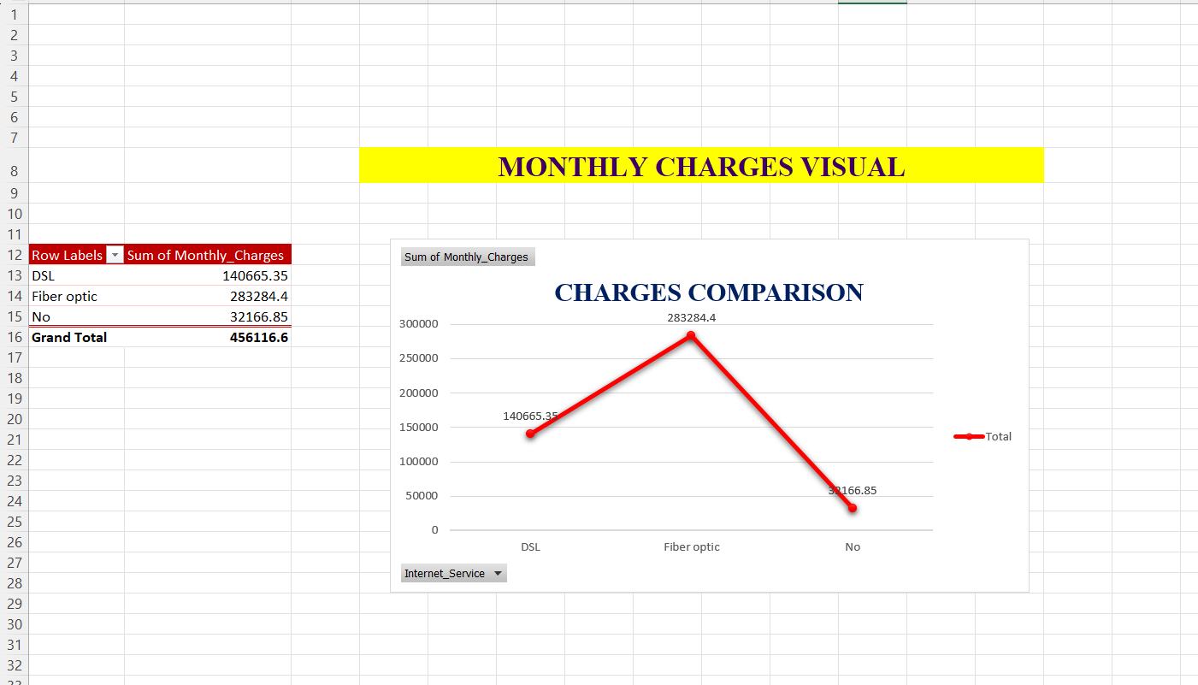
This Analysis Give the Proper Customer Lifetime values.
This Chart compares the monthly charges.

Slide 21
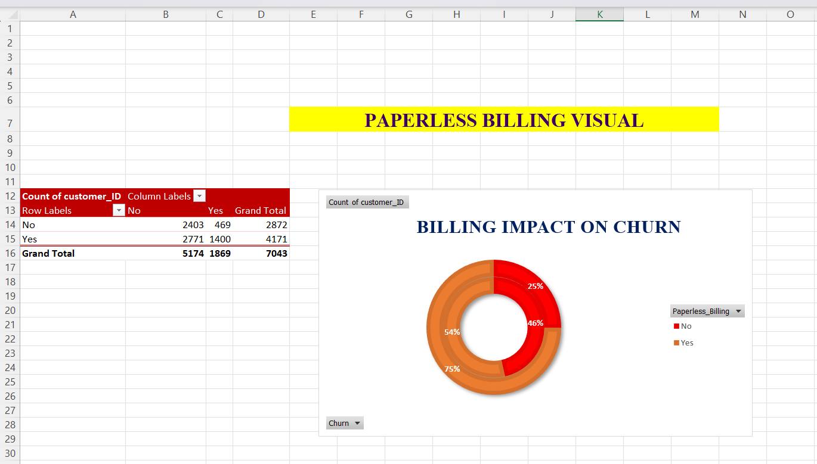
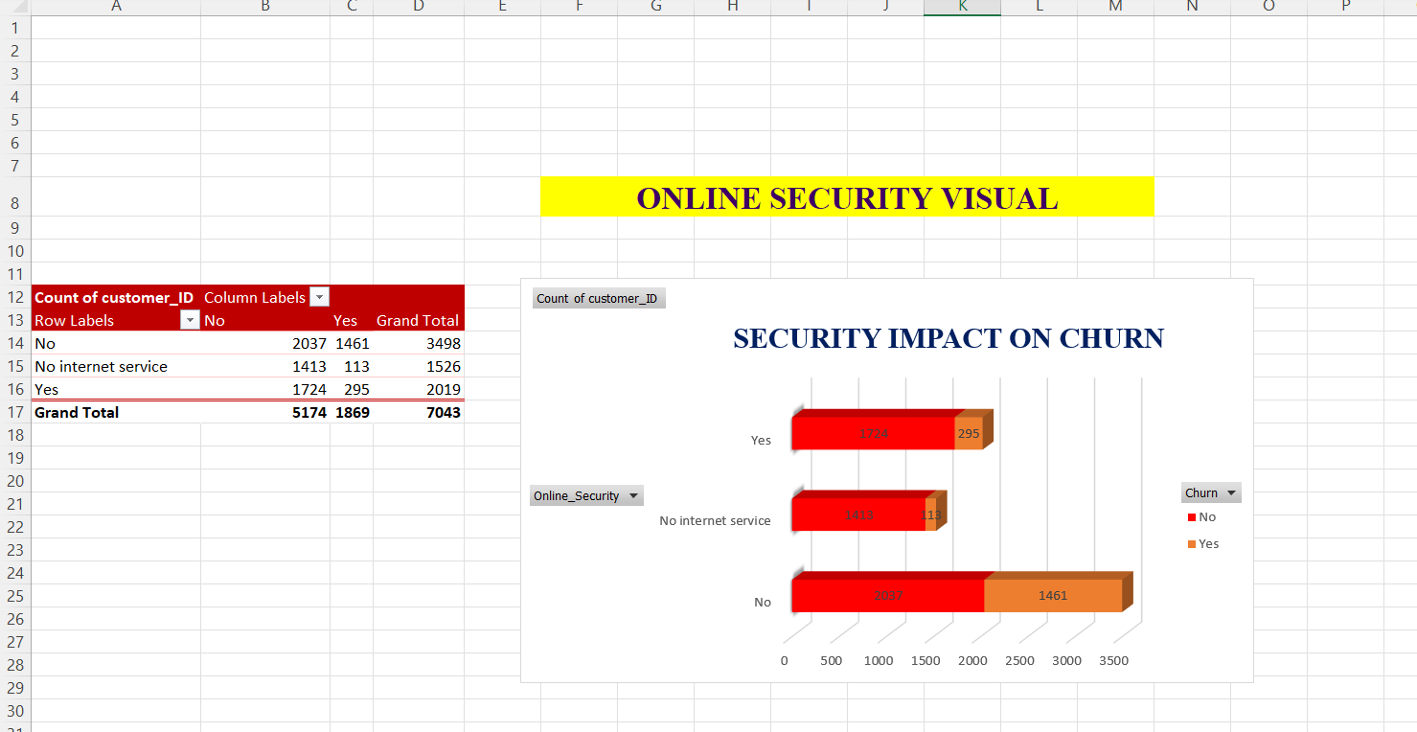
This Analysis shows the Billing impact on churn.
This Chart shows the online security impact on churn.

Slide 22
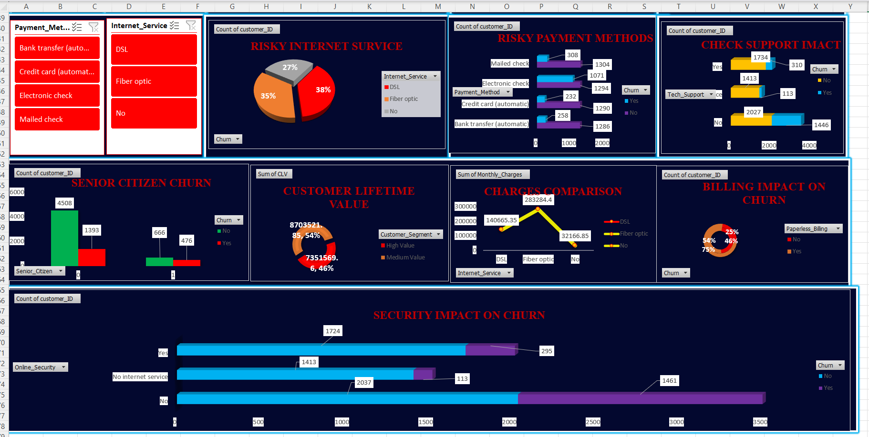
DASHBOARD

Slide 23
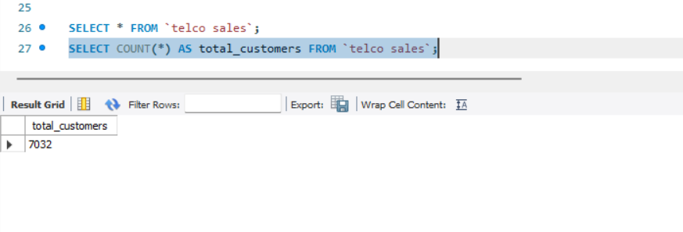
SQL QUERY
This dataset shows the telco sales details.
This query shows the count of total customers.

Slide 24
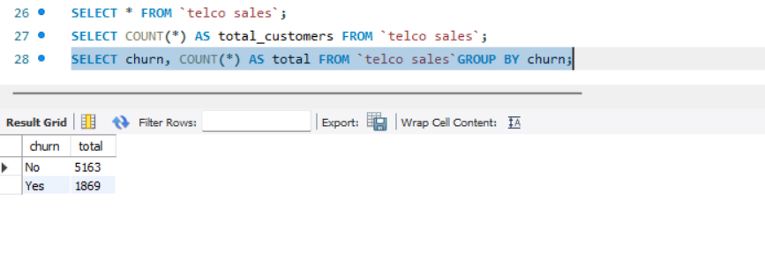
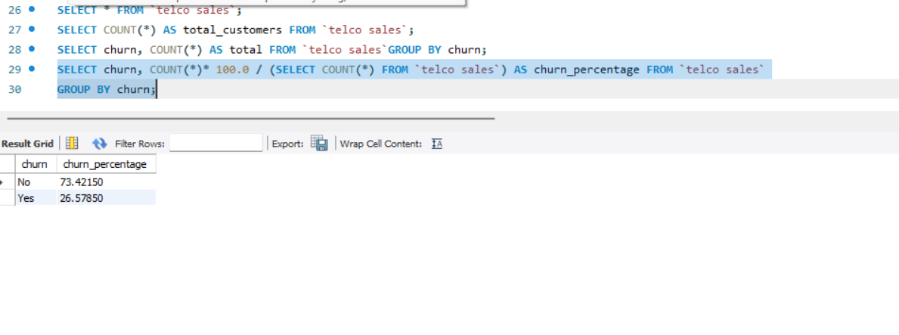
This query shows the total churn count from telco sales.
This query calculates churn percentages.

Slide 25
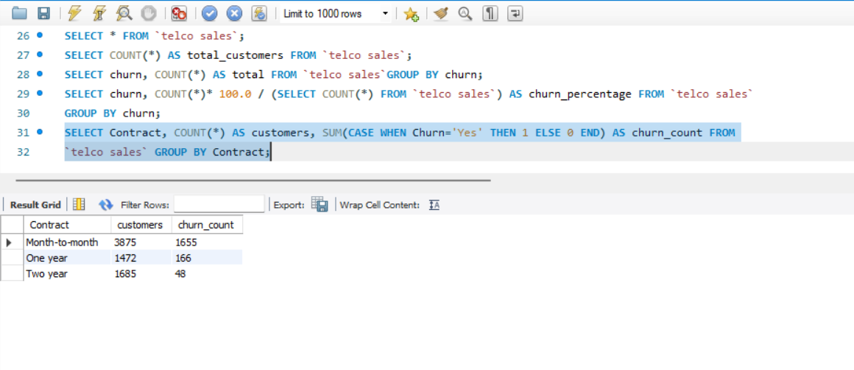
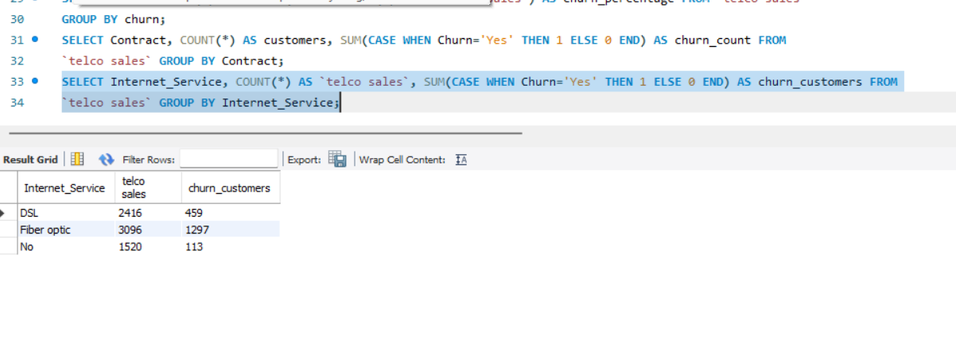
This query shows the sum of the churn count and customers based on the conditions.
This query Analysis the internet service.

Slide 26
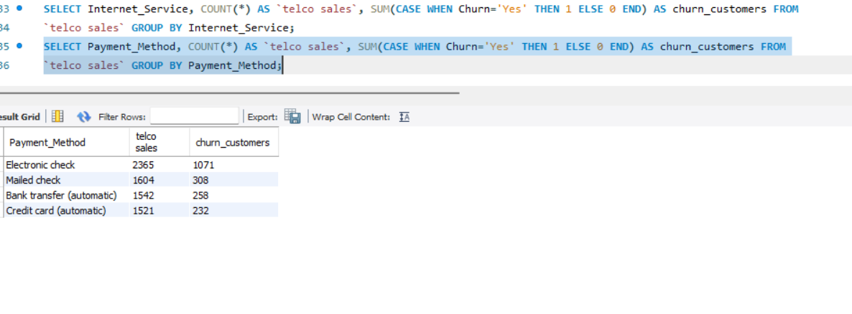
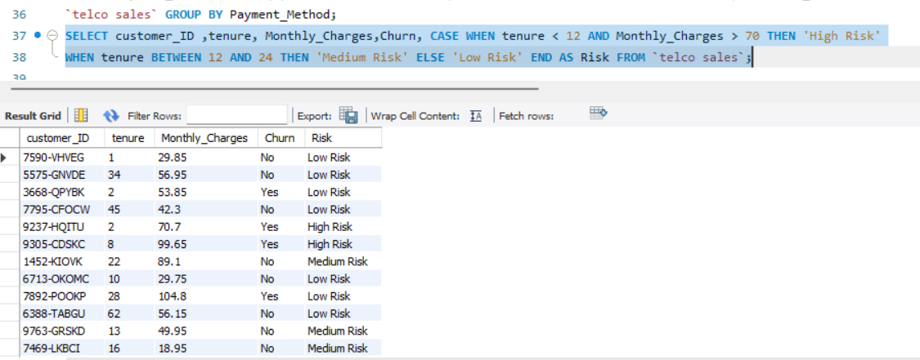
This query Analysis the churn customers payment method.
This query identify the risk of the churn customers.

Slide 27


INSIGHTS AND FINDINGS
Month-to-month contract customers show higher churn rates.
Customers without tech support are more likely to leave.
Electronic check users have higher churn probability.
Fiber optic customers show higher monthly charges.
High-value customers require better retention strategies.
Data analysis helps identify customer behavior patterns effectively.

Slide 28

CONCLUSION & FUTURE ENHANCEMENT
The project successfully analyzes customer churn and Customer Lifetime Value using Excel and SQL.
Interactive dashboards and Pivot Charts help visualize customer behavior effectively.
Risk categorization identifies high-risk customers and supports retention strategies.
SQL queries and KPI cards improve business decision-making and analytical reporting.
In future, machine learning models can be implemented for advanced churn prediction.
Power BI, Tableau, and real-time cloud databases can be integrated for enhanced analytics and scalability.

Slide 29
THANK
YOU
ALL

